Slide 1


Innovative
Integrated Magnetic Component for DAB converter
Benoit Krafft / Bruno Cogitore
ESA / SPCD 2024
18th october 2024

Slide 2
SUMMARY
Introduction
  Power electronic aspect
  Magnetic component aspect
DAB functioning overview
IMC design
  Challenges
  Simulation difficulties and work
  Electromagnetic characterization
  Losses calculation
Experimental results
Conclusion

Slide 3
POWER ELECTRONICS TRENDS
Reduce
carbon footprint
More electric launchers/satellites :
➔ More functions
➔ More power
Constraint :
Weight reduction
Innovative and challenging power electronic converters
Higher Voltage
Higher Frequency
Higher Power Density
Bidirectionnal
Topologies :
DAB/MAB resonant LLC/CLLC
interleaved converters
Active components :
GaN
transistors
ANSWER
Magnetic components :
EXXELIA develops
Integrated Magnetic Components (IMC)
Notes:
Pillar 2 “KILL the DEAD WEIGHT”

Slide 4
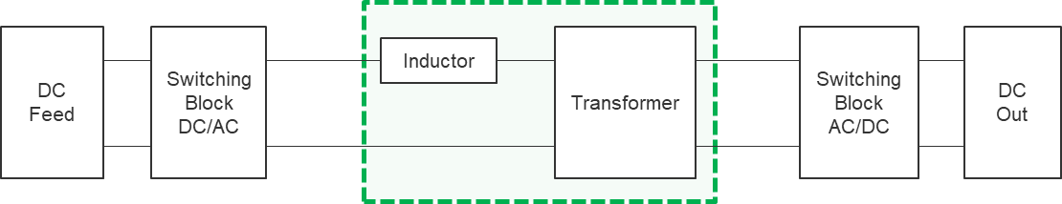
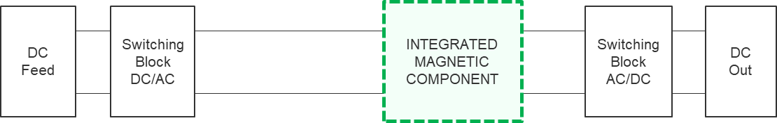
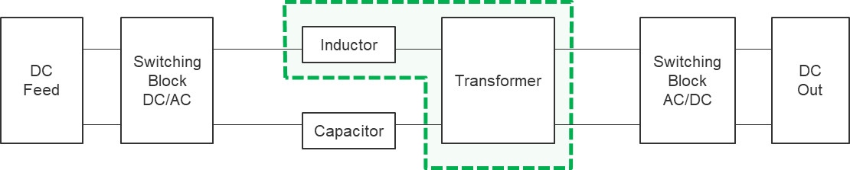
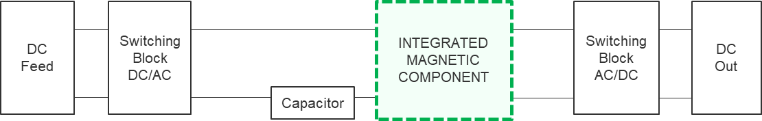
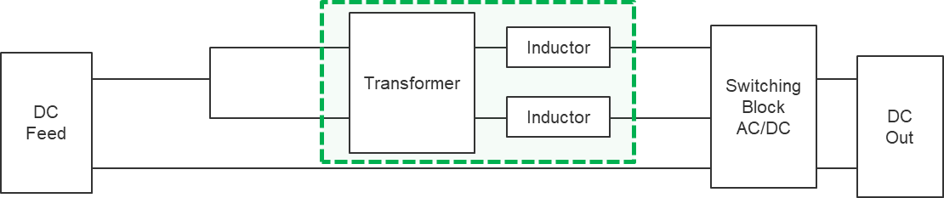
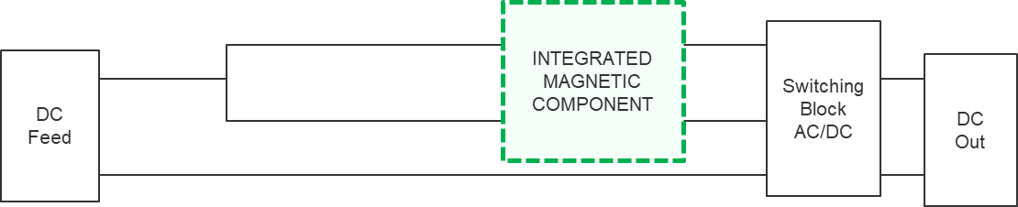
EXXELIA INNOVATION ON MAGNETIC COMPONENTS
IMC = multiple electromagnetic functions with 1 single magnetic circuit
ONE component =
1 electromagnetic function
ONE component =
2 or more electromagnetic functions
SPCD paper
Dual Active Bridge (DAB) with 2 electromagnetic components
EXXELIA
IMC
Dual Active Bridge (DAB) with one IMC
LLC resonant with 3 electromagnetic components
LLC resonant with two or one electromagnetic IMC
Interleaved converter with N Inductors
(Parallel multicell converters)
Interleaved converter with N coupled Inductors or 1 multi coupled inductor
(Parallel multicell converters)
Notes:
Les principaux convertisseurs de puissance innovants nécessaires à l’électrification utilisent une inductance en série avec un transformateur
Grâce à Smart Magnetics, l’inductance et le transformateur sont remplacés par un composant unique.
Les termes à retenir concernant les structures sont: Dual Active Bridge, LLC et Coupled Inductors

Slide 5
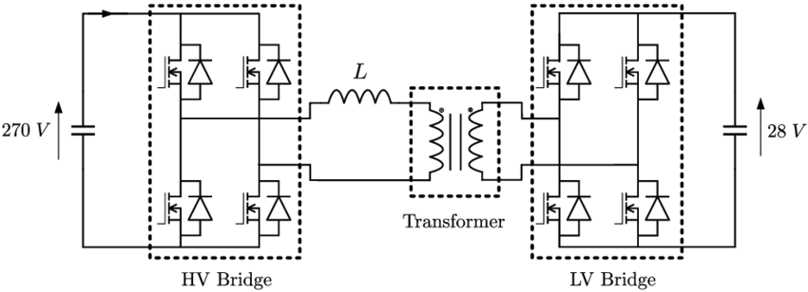
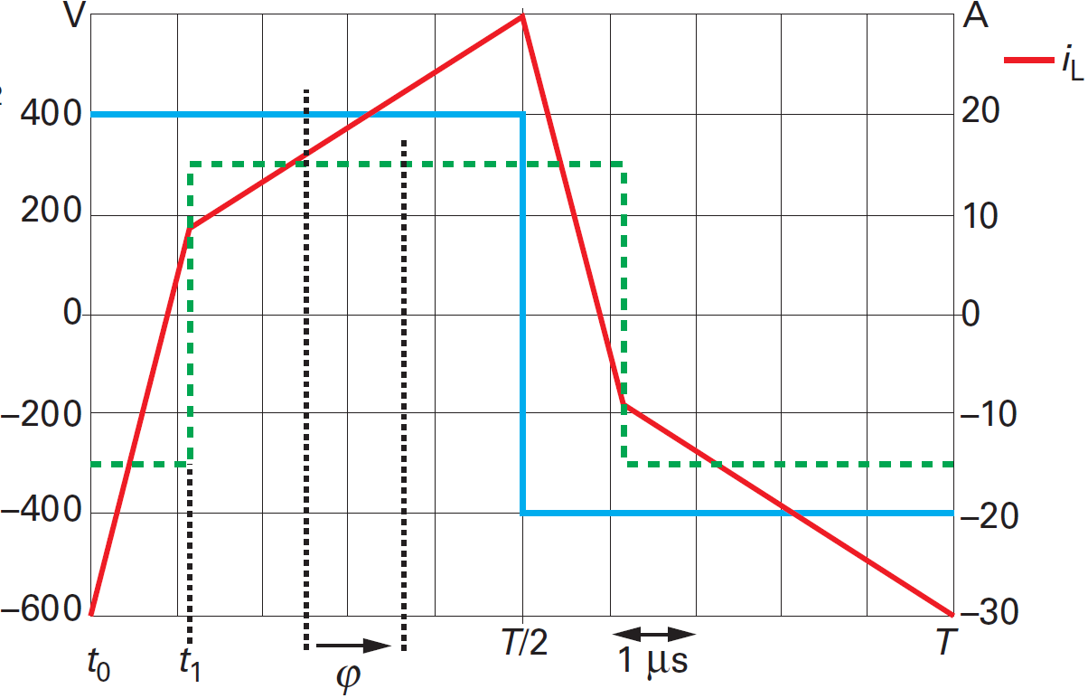
DUAL ACTIVE BRIDGE QUICK FUNCTIONING GUIDE
Main characteristics ϕ
  1 V source + 1st bridge + 1 L + 1 T + 2d bridge + 1 V α₁ α₂
  α₁ : 1st bridge duty cycle
  α₂ : 2d bridge duty cycle
  ϕ : phase shift between α₁ and α₂
2 modes of command/control
  α₁ = α₂ = 0,5 and ϕ varies ➔ « phase shift » command, case of SPCD paper
  α₁ and α₂ and ϕ varies ➔ more efficient, but more complicated to command and analyze
Phase shift basic V and I waveforms Vin Vout
  If ϕ > 0, power transfer in one direction
  If ϕ < 0, power transfer in opposite direction
  If ϕ = 0, no power transfer
Take account of total serial inductance viewed from DAB !
IMC

Slide 6
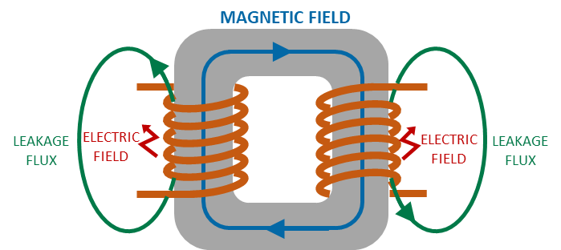
IMC FOR DAB : MAIN CHALLENGES
→ Two functions (Transformer + Inductor) with One Single magnetic circuit
Main transformer parasitic effect : Leakage inductance
  Value often too low to be used
  Significant uncontrolled variations in series production
  DAB strongly affected especially at high frequency
What about the frequency?
Aim : up to
500 kHz
Need to increase and control the mean value
Need to control and often decrease the industrial variations
Benefits
More compact
Lighter
Fit innovative architecture requirements
(High Frequency, Soft Switching …)
Higher efficiency
Better repeatability
Better reliability (1 component less)
Cost effective
Reasoning :
  Leakage Flux is out of magnetic circuit
  inside winding window
  Controlling leakage inductance leads to
  channeling/guiding leakage Flux
  Direction of work :
  Making prototypes :
  Too long and too expensive
  Analytic calculations :
  No formula applicable in general
  ➔ Finite Element Simulations (FES)
ATTENTION :
Leakage = imaginary impedance part
Most of time
more field in winding window
==> more field inside conductors
↗ imaginary part ==> ↗ real part
Real part = Copper losses
QUESTION :
How to increase leakage while reducing losses?
Notes:
Positionné ds custom design dans environnement contraint
It meets the more electric needs
Face to Face R&D des le depart
Non obsolescence policy
Obsolescence
early stage , early beginning of the project put R&D in contact

Slide 7
FES DIFFICULTIES
Get the right mathematical model
  Big variations of J (A/mm²) inside one conductor
  Inhomogeneous distribution of mean currents in conductors in parallel
  ==> magnetodynamic model with magnetic/electric coupling
  FLUX magnetoharmonic module is OK
Get the right meshing
  Automatic meshing based on triangles or tetrahedrons is often unsuitable
  Rectangles can be better
  Most of time manual meshing is required to identify compromise between time and accuracy
2D or 3D modelling?
  3D more accurate but resolution times can be too long
  We used 2D for relative studies to identify solution directions
  3D for absolute values

Slide 8
FES WHAT DID WE DO?
No industrial constraint at the beginning of the study
What are degrees of freedom?
  - Compromise between iron and copper sections ➔ define numbers of turns
  - Shape of winding section : rather rectangle or square
  - Conductor shape/type : compromise between different Eddy current types
  proximity effect, circulation currents, skin effect, losses face to an airgap
  - Coil/Turn positions in the winding window
  - Shape of magnetic circuit : compromize/ratio between L_{iron} and S_{iron}
FES used to answer 2 questions
  ① In which direction to vary each degree of freedom to
  both increased leakage
  and decrease losses
② For each geometry selected, which value of leakage and losses can be reached?

Slide 9
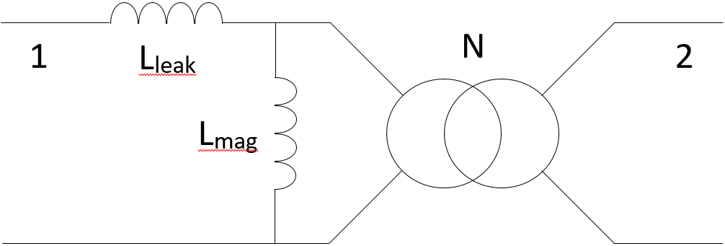
IMC CHARACTERIZATION
Need an equivalent electrical circuit to simulate the DAB functioning
Theoretical aspect
  2 winding transformer = matrix (2,2) with 3 parameters
  1 serial inductor L_{leak}, 1 // inductor L_{mag}, 1 ratio η (≈ N_{S}/N_{P})
  When L_{leak} << L_{mag} (or k ≈ 1), approximations L_{CC} = L_{leak} and L₀ = L_{mag} and η = N = N_{S}/N_{P}
  When L_{leak} < L_{mag} (or k < 1), no longer true IT’S OUR CASE !
  ➔ We have to identify 3 independant simulations to calculate L_{leak}, L_{mag}, η
Parameter calculation with FES
  Simu 1 : 1 current (primary P) supplied, 2 open circuit
  Simu 2 : 2 current (secondary S) supplied, 1 open circuit
  Simu 3 : P and S supplied with identical modulus and opposite phase currents
  We have our 3 independant parameters
η

Slide 10
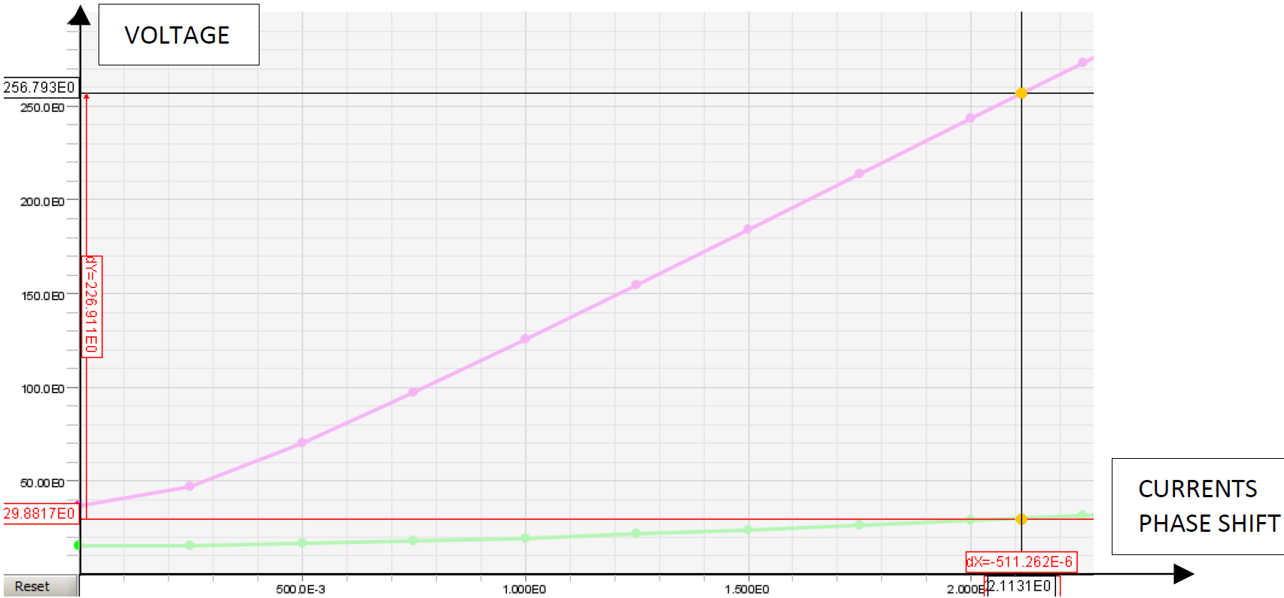
IMC LOSSES CALCULATION
In FES, not possible to supply IMC with real DAB waveforms, so
How to calculate real total copper losses?
Key point 1
  Main DAB phase shift characteristic is phase difference between P and S
  - Purple : P voltage
  - Green : S voltage
  - Drawn for currents adapted
  to our DAB example

Slide 11
IMC LOSSES CALCULATION
Key point 2
  In FES, to caculate copper losses, supply windings with current is the easisest
Simulation used
  1st step : supply 1 and 2 with sinus correct currents P and S
  2d step : adjust phase difference between 1 and 2 to obtain correct voltage/power values
  P and S losses correspond to real configuration of use (for fundamental H0 of current)
  Constraint : voltage/power level is very sensitive to phase variation
  need to be very accurate from a numerical aspect
η

Slide 12
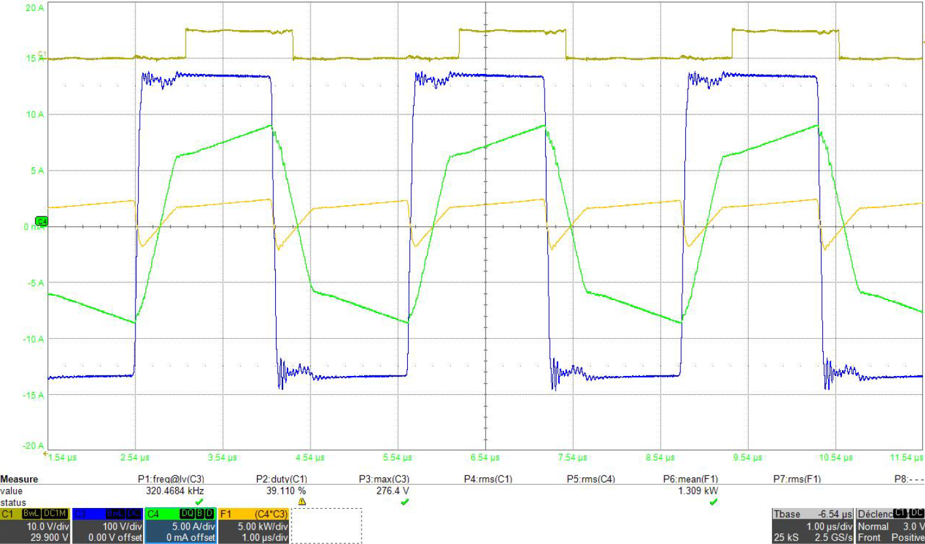
EXPERIMENTAL RESULTS 1/2
DAB characteristics :
  1,9kW / 320kHz / 270V / 28V
Experimental waveforms
: P voltage 270V
: S voltage 28V
: P current
: S current

Slide 13
EXPERIMENTAL RESULTS 2/2
Discrete magnetic component characteristics :
  Inductance : ≈ 400g
  Transformer : ≈ 400g
  Total losses : ≈ 30W
IMC characteristics
  Weight : 250g
  L₀ = 223µH – L_{CC} = 11,8µH
  Losses : ≈ 20W at nominal power
  room temperature
  whithout heatsink
  Dimensions (without connections) : 46x46x46 (LxWxHmm)
  But : industrial set-up/tuning is more complex (not manufacturing)

Slide 14
CONCLUSION
EXXELIA know-how
  Design IMC for different topologies
  Design IMC for powers from several 100W up to several 10kW
  Exemple of application : satellite ionic propulsion
  DAB generating high voltage for ionic thruster
Perspectives
  Exxelia works on IMC without magnetic circuit at frequencies between 500kHz and 1MHz
  Mass reduction aim : another 40% less

Slide 15
Thank you for your attention
Questions?
Benoit KRAFFT
Technical Manager • Exxelia Magnetics
Phone: +33 (0)3 82 59 17 32
Cell: +33 (0)6 35 22 53 79
Bruno COGITORE
Magnetic Expert / Innovation • Exxelia Magnetics
Phone: +33 (0)4 51 62 13 99
Cell: +33 (0)6 99 36 16 47

